Slide 1
Giving a Compliment

Slide 2
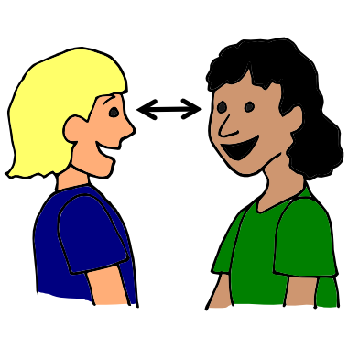
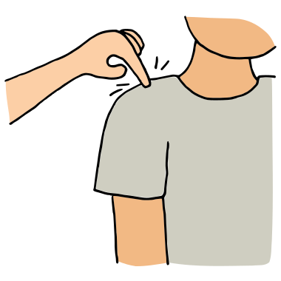
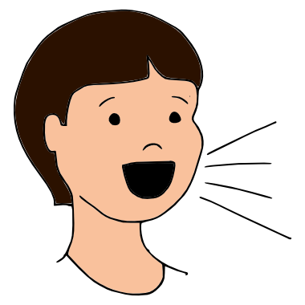
Get your friends attention..

Slide 3
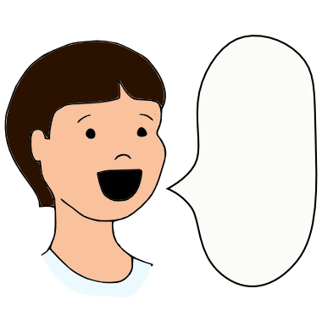
Say something nice like,” I like that” and tell them what you like” Say “Good Job” and tell them what
the good job is

Slide 4
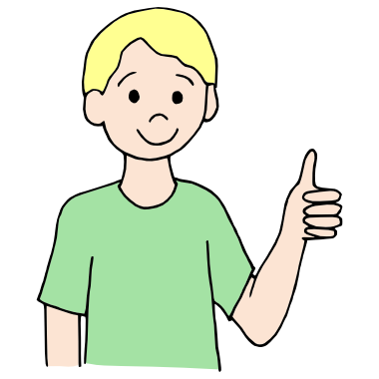
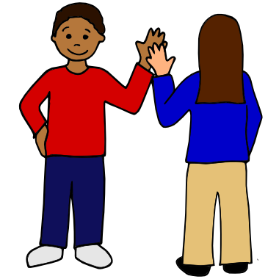
Give them a thumbs up or high five

