Slide 1
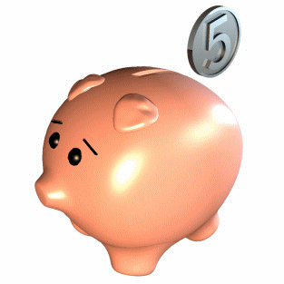
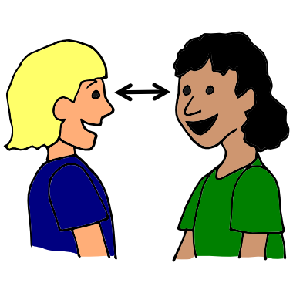
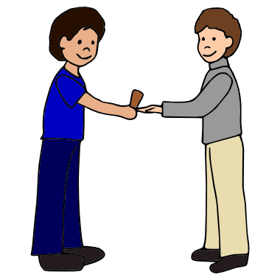
Up the Positives
Teach Friendship Skills

Slide 2
WE ARE SO GLAD THAT
YOU ARE HERE!
Virginia Stacy
Introductions

Slide 3
Grateful for…….
Curious About……
Up the Positives
Teaching Friendship Skills
Write Anything You are Grateful for and
1 Thing that you are Curious About Teaching
Up the Positives or Teach Friendship Skills to children (1 min)

Slide 4
Today
1) Up the Positives
Friendship Skills
Action

Slide 5
Why? Are these skills
Important?

Slide 6
Children who have a Strong
Foundation in Emotional Literacy
Tolerate frustration better
Get into fewer fights
Engage in less self destructive behavior
!!!!!!!!!!!!!!!
than children who do not have a Strong
Foundation in Emotional literacy What Works Briefs #21

Slide 7
Children with strong emotional literacy
ARE
healthier
less lonely
less impulsive
more focused
have greater academic achievement
What Works Briefs #21

Slide 8
Here is the Target
At least 5:1

Slide 9
BIG NEWS!!
5 Positive Statements
to Every No Don’t Stop Quit
and Question
REDUCES CHALLENGING BEHAVIOR

Slide 10
Positives:
Any Statement
that is not a
Demand.
Negatives:
No, Don’t
Stop, Quit,
Any Question

Slide 11
What Do You Want the
Child to Do?
Say What You Want
The Child to Do!
AS

Slide 12
1)Write 1
Don’t do that!
2)Write What You Want
the Child to Do!
( 1 minute)

Slide 13
Save these for Safety Concerns
NO
Don’t
STOP
QUIT

Slide 14
Stand UP
Do 30 Seconds
Of Energizing
Moves then
Kiss Your Brain!

Slide 15
Up the Positives for:
Following Directions
Behavior
Activity
Skills

Slide 16
Positives for Following Directions
You got a book to read.
You got your shoes and your coat.
Thanks for getting your backpack.
4.
5.
Write 2 more Positives that a
Teacher can use for Following Directions
Type Your Favorite in the Chat Box

Slide 17
Positives for Behavior
You took 3 breaths and calmed down.
You are a friend, you shared the toy.
You waited for Erika to go down the slide.
4)
5)
Write 2 More Positives a Teacher Can Say for Behavior (1 min)

Slide 18
Positives for a Parent Doing an Activity with a Child
You told Jose exactly what to do.
You pointed to the puzzle piece he needed next
When she finished, you said, “You did it!”
4)
5)
Write 2 More Positives that You Can Say to a Parent
AS Experience

Slide 19
Positives for Your Co-Workers
You noticed Joey was not playing.
You told Jasmin what she did well!
You said “Use Your walking Feet”.
4)
5)

Slide 20
Positives for Skills
You picked up all the toys.
You ran fast!
You wrote a B!
4)
5)
Write 2 Positives a Teacher Can Use for a Child’s Skill

Slide 21
To the Breakout Room We Go
Introduce Yourselves.
Start with the Person whose name is
closest to the letter A
Share your 2 favorite Positive Descriptive Statements
that you wrote down. Everyone shares!
6 minutes Explain

Slide 22
Sharing: Increasing the Positives
Start with the person whose name
Is closest to the Letter Z. Say one
thing that stood out to you about
Increasing the Positives

Slide 23
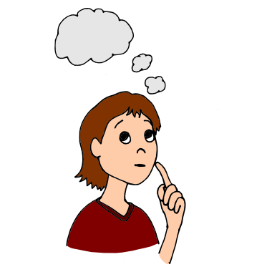
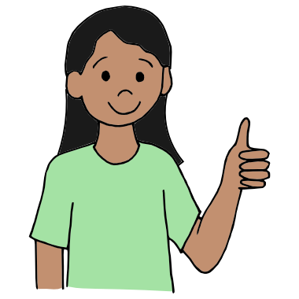
Remember: WE ALL NEED POSITIVES.
CHILDREN
CAREGIVERS
CO-WORKERS
FAMILIES
AS

Slide 24
CHAT
ING
with the

Slide 25
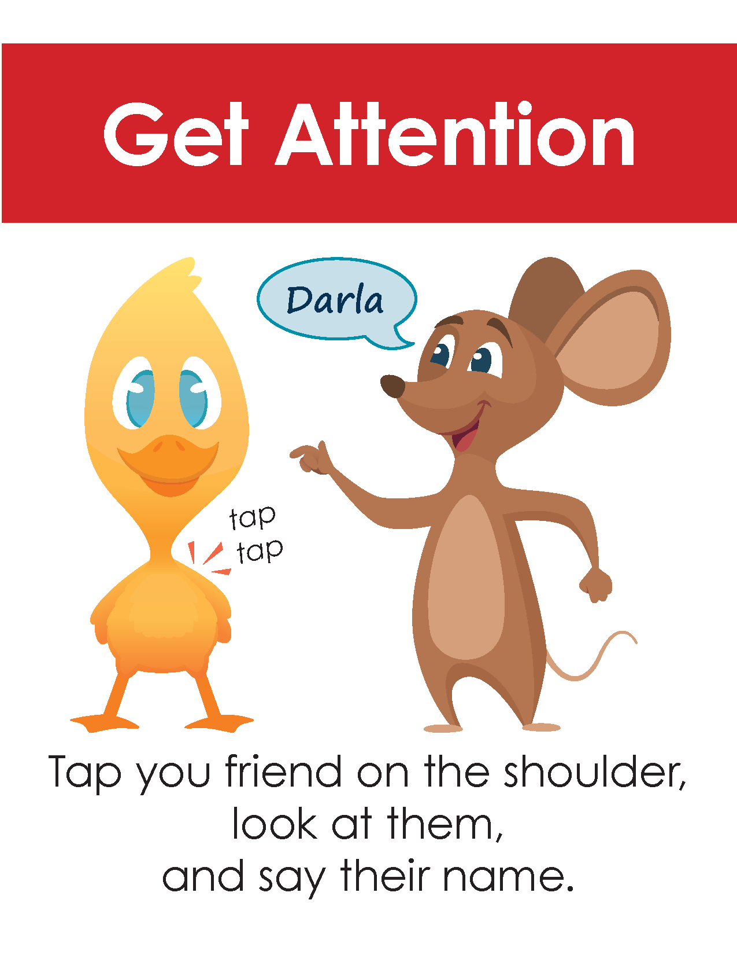
Friendship Skills
1) Getting a Friends Attention
2) Sharing (giving)
3) Sharing (asking)
4) Giving a Play Idea
5) Giving a Compliment
Posters are available on
The National Pyramid Model Center for Innovations website
challengingbehavior.cbcs.usf.edu go to Implementation
Programwide Practical Strategies Show posters
AS Using Visuals to Teach

Slide 26
Getting Your Friend’s Attention
Show Social Story. Story in Conference Handouts

Slide 27
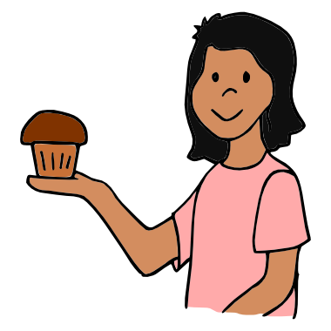
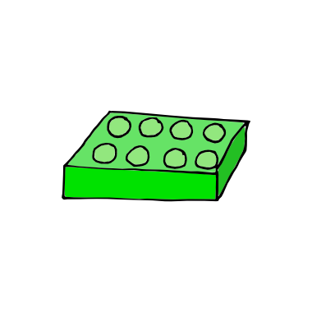
Giving
Show Social Story. Story in Conference Handouts

Slide 28
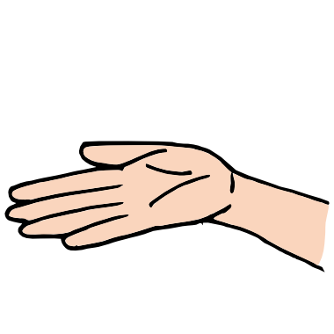
Asking
Can I
Have
That?
Show Social Story. Story in Conference Handouts

Slide 29
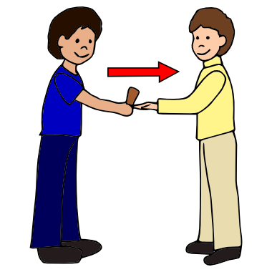
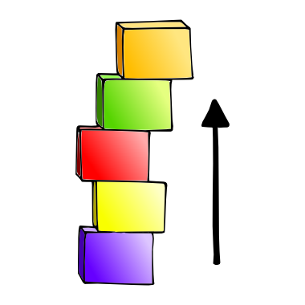
Giving a Play Idea
Show Social Story. Story in Conference Handouts

Slide 30
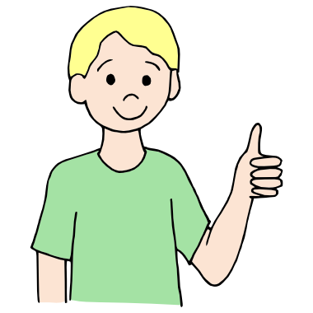
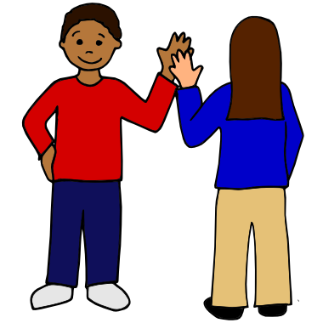
Giving a Compliment
Show Social Story. Story in Conference Handouts

Slide 31
Write Your Questions about teaching
Friendship Skills and Increasing
the Positives in the Chat Box

Slide 32
Action!
Write:
How you will teach the first skill,
Getting Attention
2 MIN

Slide 33
Thank You!

Slide 34
Contact Us:
Virginia: virginiakile@gmail.com
Stacy: Stacy.Trickel@mcsd.org

Slide 35
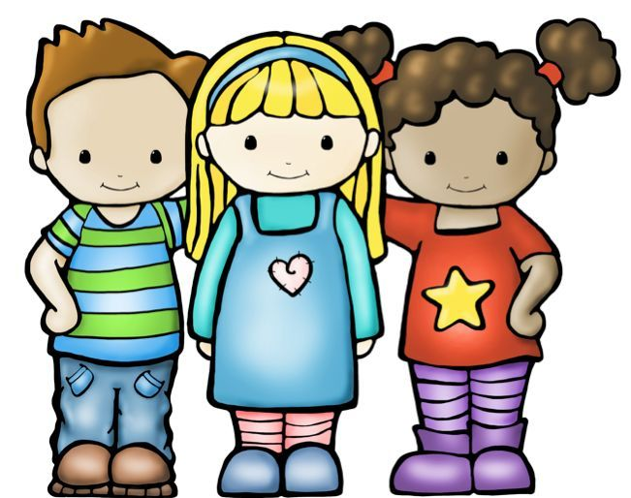
What I Teach Matters!

